Slide 1
2024年2月5日更新
医師国家試験の医学英語関連問題について
1. 傾向（108ー118回）
(1) 108回以降2〜5問出題。
(2) 問題数は増加傾向（114, 115回は4題、116,117回は5題、118回は4題）
(2) 語彙力を問う問題から臨床的知識を問う問題へ
(3) 紹介状、カルテ、画像、症例報告を用いた形式の問題へ
2. 必要な対策
(1) 医学英語授業：語彙力、読解力、コミュニケーション能力の基盤を身につける。
(2) 基礎、臨床専門教育：英語の文献、資料、論文を積極的に活用する。
(3) 臨床実習：英語の症例報告を読み、英語で発表する。医療面接演習を行う。
(4) その他：在学中に医学英語検定３、４級に合格する。

Slide 2
第118回の問題: 118A-50
An 85-year-old woman was admitted to the hospital with a left femoral neck fracture and was confined to bed rest. On admission, muscle strength and sensation in the left lower limb were normal, but the next day, she was unable to move her left foot upwards. On examination, she was unable to dorsiflex her left ankle, with decreased sensation on the dorsal aspect of her left foot. The left lower limb was externally rotated.
Select the most likely cause of her decreased ankle movement.
a) Cerebral infarction
b) Lumbar disc herniation
c) Peroneal <Fibular> nerve palsy
d) Deep vein thrombosis
e) Achilles tendon rupture
Answer: c

Slide 3
第118回の問題: 118B-13
Which of the following clinical conditions occurs in patients acutely after severe burns?
a) polyuria
b) hyperlipidemia
c) hypovolemic shock
d) venous thrombosis
e) compartment syndrome
Answer: c

Slide 4
第118回の問題: 118E-4
Which is NOT the correct combination between the risk factor and its associated disease?
a) smoking - bladder cancer
b) lack of physical activity - colon cancer
c) obesity after menopause - breast cancer
d) excessive alcohol consumption - esophageal cancer
e) excessive dietary sodium intake - lung cancer
Answer: e

Slide 5
第118回の問題: 118E-28
An ambulance brought a 28-year-old man to the emergency room. He was found on the street unconscious.
In his wallet, he had a memo stating, "I have thrombocytopenia from aplastic anemia. If I pass out, please obtain a CT scan to rule out intracranial hemorrhage immediately. Thank you in advance.”
Which test should you order next?
a) head CT
b) brain MRI
c) serum alcohol level
d) serum ammonia level
e) electroencephalogram
Answer: a
Answer: a

Slide 6
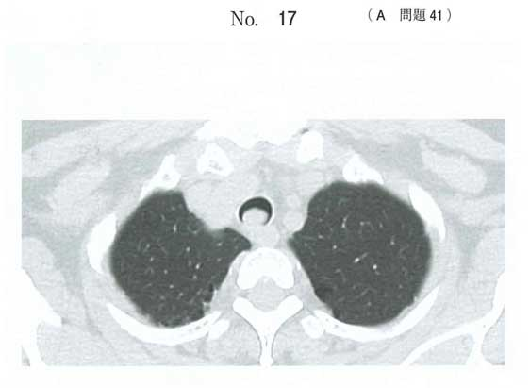
第117回の問題: 117A-41
52歳の女性。呼吸困難を主訴に来院した。3か月前から呼吸困難が出現し自宅近くの診療所を受診して胸部エックス線撮影を施行されたが異常は指摘されなかった。喘息と診断され加療を受けたが改善せず、最近は徐々に呼吸困難が強くなっていると感じている。体温36.8℃。血圧118/64 mmHg。呼吸数24/分。SpO294% (room air)。胸部単純CT（別冊No. 17）を別に示す。
この患者で聴取される呼吸音として最も可能性が高いのはどれか。
a) stridor
b) wheezes
c) friction rub
d) fine crackles
e) coarse crackles
Answer: a

Slide 7
第117回の問題: 117B-5
診療録におけるSOAPのAに該当するのはどれか。
a) 現病歴
b) 鑑別疾患
c) 検査結果
d) 身体所見
e) 治療計画
a) History of present illness: Subjective data (S)
b) Differential diagnosis: Assessment (A)
c) Workup: Plan (P)
d) Physical exam: Objective data (O)
e) Management: Plan (P)
Answer: b

Slide 8
第117回の問題: 117B-8
Which of the following diseases needs airborne precautions?
a) herpes
b) influenza
c) mumps
d) rubella
e) varicella
Answer: e

Slide 9
第117回の問題: 117C-28
日常生活動作（ADL）の評価法はどれか。
a) Barthel Index (BI)
b) Japan Coma Scale (JCS)
c) Glasgow Coma Scale (GCS)
d) Brief Psychiatric Rating Scale (BPRS)
e) Mini-Mental State Examination (MMSE)
Answer: a

Slide 10
第117回の問題: 117D_52
A 35-year-old man complained of a sudden onset of severe headache. For the past two weeks, he woke up around 3:00 a.m. due to soreness behind the left eye. His pain continued for about an hour. Today, he visited the emergency department at 5:30 a.m.
His consciousness was clear, but he appeared restless. His body temperature was 36.4℃. Pulse rate was 84/min. Blood pressure was 136/80 mmHg. Conjunctival hyperemia and tearing of the left eye were observed. There were no meningeal signs. MRI and MRA of the head showed no abnormalities.
What is the most likely diagnosis?
a) migraine
b) meningitis
c) brain tumor
d) cluster headache
e) subarachnoid hemorrhage
Answer: d

Slide 11
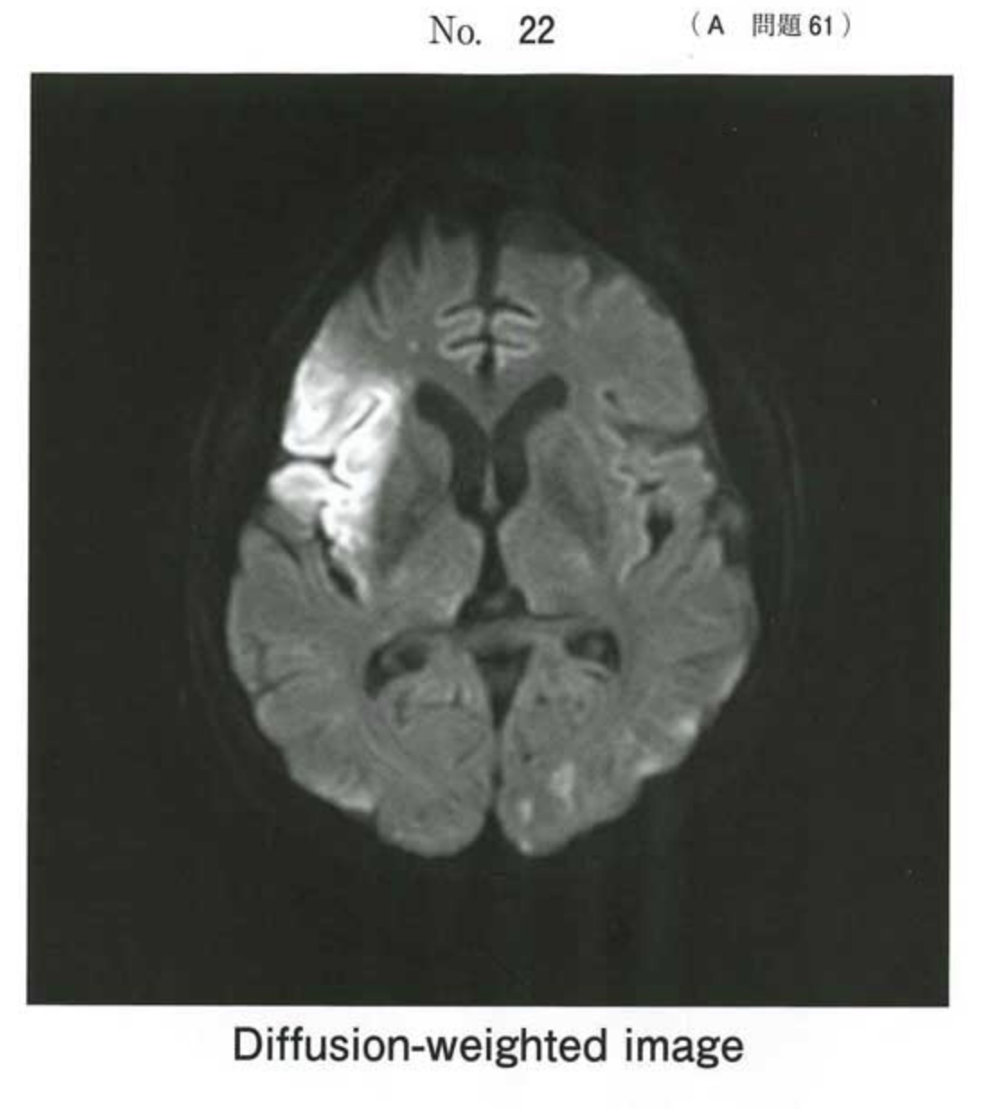
第116回の問題: A問題 61
A 64-year-old man was brought to the emergency department because of left hemiplegia with impaired consciousness. On physical examination, consciousness level was GCS E4V4M6, blood pressure 164/84 mmHg, pulse rate 96/min and irregular. Neurological examination was unremarkable except for left hemiplegia. No carotid bruit was heard on either side. Brain MRI is shown in the figure.
Which of the following is the most
likely ECG diagnosis?
a Atrial fibrillation
b Supraventricular tachycardia
c Third-degree atrioventricular block
d Ventricular fibrillation
e Ventricular tachycardia
Answer: a

Slide 12
第116回の問題: C問題 23
Which is the most likely personal information that can be used to identify an individual person?
a ABO blood type
b Annual income
c Date and place of birth
d Occupation
e Past medical history
Answer: c

Slide 13
第116回の問題: E問題 15
疾患と聴診所見の組み合わせで正しいのはどれか。
a COPD - stridor
b 胸膜炎 - rhonchi
c 石綿肺 - fine crackles
d 肺水腫 - Hamman’s crunch
Answer: c

Slide 14
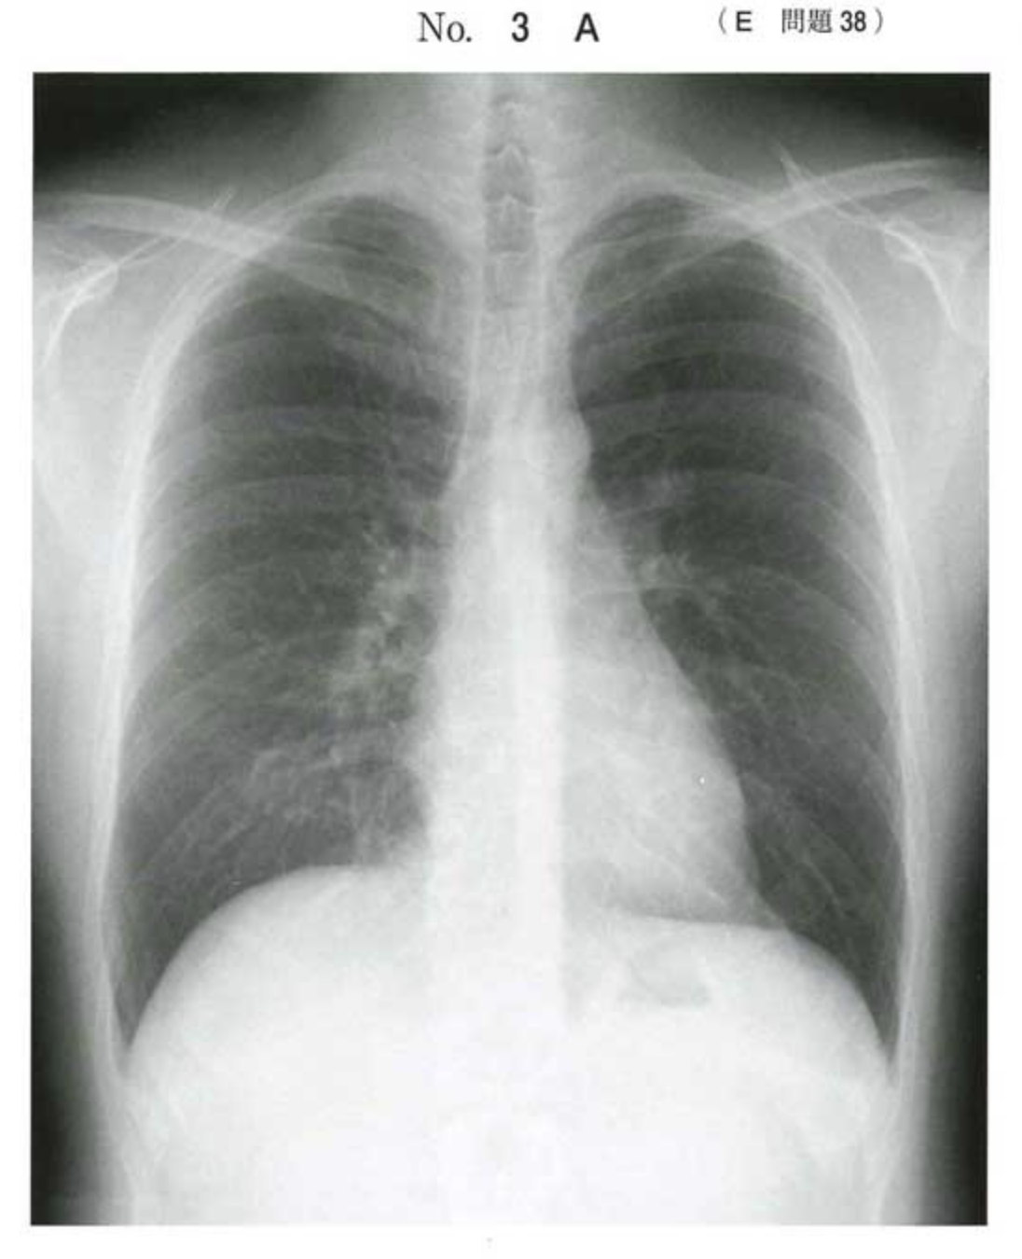
第116回の問題: E問題 38
A 21-year-old previously healthy man presented to the emergency room with chest pain, which was worse on breathing lasting for two days.
Lung and heart examinations were unremarkable. Chest X-ray and ECG are shown in the figure.
What is the most likely diagnosis?
a Herpes zoster
b Myocardial infarction
c Pericarditis
d Pneumothorax
e Pulmonary embolism
Answer: c

Slide 15
第116回の問題: F問題 11
すべての人が、適切な保健医療サービスを必要時に支払い可能な費用で受けることができる状態を目指す、国際保健分野の取り組みの英語名称はどれか。
a Universal Health Coverage (UHC)
b Sustainable Development Goals (SDGs)
c Official Development Assistance (ODA)
d International Health Regulations (IHR)
e International Classification of Disease (ICD)
Answer: a

Slide 16
第115回の問題: A問題 6
Which is the incorrect description about Zika virus infection?
a) Mosquitoes transmit Zika virus.
b) Incubation period is usually up to 14 days.
c) Symptoms usually persist for up to 7 days.
d) The infection during pregnancy can cause microcephaly of the new born.
e) Acyclovir is used for treatment.
Answer: e

Slide 17
第115回の問題: B問題 32
A 60-year-old man presented with sensory disturbance of his fingers and toes. He lived alone and drank alcohol every day. The amount of his alcohol intake was over 60g/day. He had muscle weakness and burning sensation of his extremities. Examinations showed nystagmus and heart failure.
Which of the following vitamins is related to his symptoms?
a) Vitamin A
b) Vitamin B1
c) Vitamin B6
d) Vitamin C
e) Vitamin D
Answer: b

Slide 18
第115回の問題: C問題 13
Choose the disease that is under sentinel surveillance in Japan, and does not require reports from all medical institutions.
a) Measles
b) Mumps
c) Pertussis
d) Rubella
e) Syphilis
Answer: b

Slide 19
第115回の問題: C問題 25
The purpose of this neonatal screening test using the filter paper card is the early detection for inborn errors of metabolism.
Which of the following is the most appropriate?
a) The paper should be dried by hot air.
b) Blood is generally collected from the heel of the infant.
c) Optimal time for collection is within 24 hours after birth.
d) Blood should be applied to both sides of the filter paper card.
Answer: b

Slide 20
第114回の問題: A問題 31
A 26-year-old woman presented to the emergency room with palpitations and shortness of breath that started suddenly while she was eating breakfast. Although the health-screening examination performed three weeks ago showed delta waves in her ECG, echocardiography taken at a nearby hospital showed no abnormal findings. At presentation, she was slightly hypotensive with a blood pressure of 96/68 mmHg. Her ECG on admission showed a narrow QRS-complex tachycardia at a rate of 180/min. Neither ST elevation nor T wave abnormality was present.
What is the most probable diagnosis of the arrhythmia?
a Sinus tachycardia
b Sick sinus syndrome
c Ventricular tachycardia
d Supraventricular tachycardia
e Complete atrioventricular block
Answer: d

Slide 21
第114回の問題: D問題 63
A 65-year-old woman was diagnosed with stage IB right lung cancer. She underwent right lower lobectomy with lymph node dissection for the cancer. She developed a milky white pleural effusion of 860 mL, which was drained after starting meals on the first postoperative day.
Which pleural effusion test should be performed for a definitive diagnosis?
a Protein
b Bacteria
c Triglyceride
d Malignant cells
e White blood cells
Answer: c

Slide 22
第114回の問題: E問題 35
A 42-year-old woman came to your clinic, anxious about a mass in her left breast. On physical examination, the mass was hard and fixed neither to skin nor to muscle. No axillary lymph nodes were palpated on either side. Mammography showed an invasive ductal carcinoma. No metastases were detected on chest/abdominal CT or on bone scintigraphy.
What is the most appropriate plan at present?
a Breast surgery
b Estrogen administration
c NSAID administration
d Observation
e Whole body irradiation
Answer: a

Slide 23
第114回の問題: F問題 22
2歳の男児の予防接種歴を記載した証明書を以下に示す。
この男児が予防接種を受けていないのはどれか。
a 水痘
b 麻疹
c 百日咳
d 肺炎球菌
e 流行性耳下腺炎
Answer: e

Slide 24
第113回の問題: B問題34
A 25-year-old man comes to your clinic complaining of abdominal pain for the past two days. Yesterday, the pain was periodic and located around the periumbilical area. Today the pain is persistent and located in the right lower quadrant. He feels feverish. He does not smoke or drink alcohol. His body temperature is 37.7℃, blood pressure is 126/62 mmHg, and pulse rate is 94/min, regular.
Which of the following should be done next?
a perform a CRP test
b examine for peritoneal irritation
c administer a broad-spectrum antibiotic
d perform an abdominal CT with contrast
e perform an upper gastrointestinal endoscopy
Answer: b

Slide 25
第113回の問題: E問題 41
63歳の女性。7月末の正午過ぎ、救急外来に日本語の話せない外国人女性が救急車で搬入された。救急車で同行した配偶者（外国人）が病院の臨床修練外国医師に話した内容と患者の所見をまとめた診療記録を示す。
The patient felt faint while walking on the beach. Shen then sat under a shade where she vomited. She complained of headache and dizziness before fainting. Her face turned red and her breathing became rapid.
Physical examination
• Body temperature: 39.2℃.
• Conscious level: Glasgow Coma Scale E3 V4 M5.
• Skin: generally hot, flushed and dry.
• Heart rate: 140/min, regular.
• Blood Pressure: 86/60 mmHg.
• Respiratory rate: 24/min, shallow.
• No hemiplegia.
• Muscle spasms in limbs.
まず行うべきなのはどれか。
a Chest CT
b Body cooling
c Oral water intake
d Tracheal intubation
e Antibiotics infusion
Answer: b

Slide 26
第112回の問題: B問題32
救急外来に日本語を話せない40歳の外国人女性が来院した。病院に勤務している外国人医師が英語で医療面接と身体診察とを行い、記載した診療録の一部を示す。
Presenting Complaint: Severe lower abdominal pain.
History of presenting complaint: Sudden onset of right lower abdominal pain 6 hours ago. Pain has been gradually worsening. Slight nausea but no vomiting or diarrhea. Last menstruation was 9 weeks ago. She noticed vaginal spotting* 3 days ago.
Past medical and social history: Appendectomy at 18. Married.
Examination: Temperature 36.3℃. Right lower abdominal tenderness without rebound tenderness. Bowel sounds are reduced.
*vaginal spotting（少量の性器出血）
可能性の高い疾患はどれか。
a Crohn's disease
b Ectopic pregnancy
c Pelvic inflammatory disease
d Premenstrual syndrome
e Ureterolithiasis
Answer: b

Slide 27
第112回の問題: E問題31
北米での医学会参加のため搭乗していた旅客機内でドクターコールがあり対応した。目的地の空港のスタッフに情報提供した方が良いと判断し、乗務員に伝えたところ、「所見をメモして欲しい」と依頼され記載した文面を示す。
A 78-year-old female passenger has developed swelling of her left lower leg towards the end of a long-haul flight. She does not complain of any pain at rest.
She has pitting edema of there left lower leg, but no color or temperature changes are observed. Calf pain is induced on dorsiflexion of her left foot.
Because she suffers from shortness of breath, the possibility of pulmonary embolism should be considered and transfer to an appropriate hospital is advised.
原因として考えられるのはどれか。
a Acute kidney injury
b Deep venous thrombosis
c Femoral neck fracture
d Heart failure
e Peripheral arterial disease
Answer: b

Slide 28
第111回の問題: C問題17
救急外来に日本語の話せない68歳の外国人男性が来院した。対応した臨床修練外国医師が診察と検査を行い記載した診療録の一部を示す。
Presenting complaint: Abdominal pain at the left lower quadrant.
History of present complaint: Sudden onset of sharp pain at the left lower abdomen 3 days ago. Associated with nausea and chills.
Examination:
Temperature 37.2℃
No pallor or jaundice.
Generalized abdominal distention with abdominal tenderness and localized rebound tenderness at the left lower quadrant. Bowel sounds are reduced.
No tenderness or mass on rectal examination.
Investigation:
WBC count: 11,300/μL, CRP: 9.8 mg/dL.
CT: multiple small pouches with thickened bowel walls of the sigmoid colon.
診断はどれか。
a Crohn’s disease b Sigmoid volvulus
c Acute appendicitis d Sigmoid diverticulitis
e Meckel's diverticulosis
Answer: d

Slide 29
第111回の問題: H問題24
観光旅行中に倒れたという外国人女性が救急車で搬入された。大きく呼びかけるとかすかに目を開くが意思の疎通は取れない。同行の友人によると持病があるとのことで、女性のかかりつけ医から預かった手紙を差し出した。
To whom it may concern:
This is to inform you that Ms. XXX (Birth Date 3/14/1998) has 21-hydroxylase deficiency. Her condition has been well-controlled with 9 alpha-fludrocortisone and hydrocortisone. Although she does not experience any problems during her daily activities, there is a small but certain possibility that she falls into a state of adrenal failure, especially if she is confronted with severe stress on her week-long trip to Japan.
If she complains of severe fatigue, fever, anorexia, or is found unconscious, please give her intravenous hydrocortisone and sodium-containing fluid, and contact an endocrinologist immediately.
Thank you for your cooperation.
YYY, M.D.
ZZZ Clinic
まず行うべき処置はどれか。
a 副腎皮質ステロイドの静注と乳酸リンゲル液の点滴静注
b 副腎皮質ステロイドの静注と5%ブドウ糖液の点滴静注
c 20%ブドウ糖の静注と5%ブドウ糖液の点滴静注
d アドレナリンの皮下注と生理食塩液の点滴静注
e アドレナリンの筋注と生理食塩液の点滴静注
Answer: a

Slide 30
第110回の問題: C問題20
61歳の男性。自営業。旅客機内で耐え難い全身倦怠感を訴えた。2週間の仕事を終えて東アジアのある国から帰国するところである。たまたま同乗していた医師が機内アナウンスに呼応した。男性が現地の医療機関を昨日受診した際に渡された紹介状の一部を示す。
The patient is a 61-year-old man with a complaint of general malaise. Distended abdomen has been developed in these two days. He has a long history of drinking. However, he has never been treated on alcoholic problems.
On physical examination, his consciousness was clear. He had no fever. Icterus on his conjunctiva, several vascular spiders in his anterior chest and bilateral pretibial edema were observed. Moderate amount of ascites was detected by ultrasonography.
Therefore, I strongly recommended him to consult a physician in his home country as soon as possible.
機内での現症: 体温36.5℃。脈拍88/分、整。呼吸数12/分。腹部に圧痛を認めない。
この情報から最も疑うべき疾患はどれか。
a 肝硬変
b 心不全
c 深部静脈血栓症
d 甲状腺機能低下症
e ネフローゼ症候群
Answer: a

Slide 31
第110回の問題: I問題5
5) 急性胆嚢炎の治療はどれか。
a EST (Endoscopic Sphincterotomy)
b EBS (Endoscopic Biliary Stenting)
c ENBD (Endoscopic Nasobiliary Drainage)
d EPBD (Endoscopic Papillary Balloon Dilatation)
e PTGBD (Percutaneous Transhepatic Gallbladder Drainage)
Answer: e

Slide 32
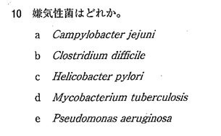
第109回の問題: A問題10
Answer: b

Slide 33
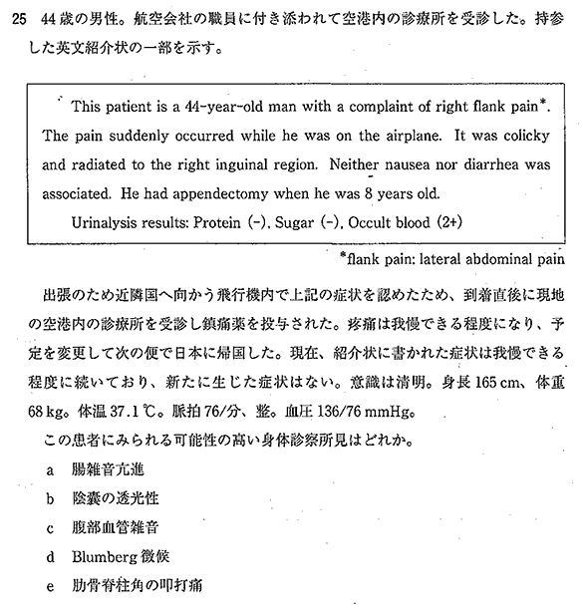
第109回の問題: F問題25
Answer: e
Notes:
臨床問題では、近年では初めて英語を取り入れた問題が出題されました（F-25）。エボラ出血熱などの時事トピックスを意識したかのような、「海外から帰国し空港内の診療所」というシチュエーションで、海外で受診した際の英文紹介状が提示されました。それほど難しい英単語はなく、正答率も平均的と思われますが、新しい形式であった分、解答までには時間がかかったのではないかと思います。

Slide 34
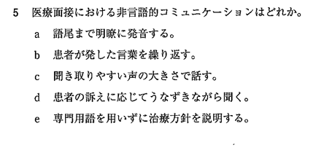
第109回の問題: C問題5
Answer: d

Slide 35
第108回問題: C問題12
頭部にみられる病的所見はどれか。(Which of the following is an abnormal physical finding in the HEENT?)
a. asterixis
b. clubbing
c. gynecomastia
d. nystagmus
e. scoliosis
Answer: d

